Slide 1

E-Commerce Website
SUBMITTED BY :-
Name :- Jada Sujan Kumar
Registration Number :- 11808434
Section :- RK18XC
Submitted to Ruchita Duggal mam

Slide 2
contents
Introduction.
Introduction to my project
Languages used
Screen Recording of the project
Video on the whole project

Slide 3
Introduction :-
Many People uses the Ecommerce Website like amazon.in,Filpkart,Myntra…etc for shopping online.
The basic functionality of the website is to display the various items available to the customer.
If the customer likes the product he may buy the product or save it in cart or wishlisht to purchase later.

Slide 4
I think It’s a good project for any web development student as it has several functions to perform and it needs different languages to develop a website like amazon.in
I felt very happy that I got this project to do and I completed this project by myself and I didn’t copied anything from Internet or from my friends

Slide 5
Introduction to my Project
Since It’s a front-end webdevelopment project I mainly used HTML5,Boostrap,Css,Java Script,
Jquery to complete this project.
I had taken mainly Myntra,amazon.in websites for my reference to develop a design and I had downloaded all my images from there only to complete my project.
I named my webpage as SK Online Shopping where SK stands for Sujan Kumar which is my name.

Slide 6
Languages used :-
HTML5
CSS
Java Script
Boostrap
Jquery

Slide 7
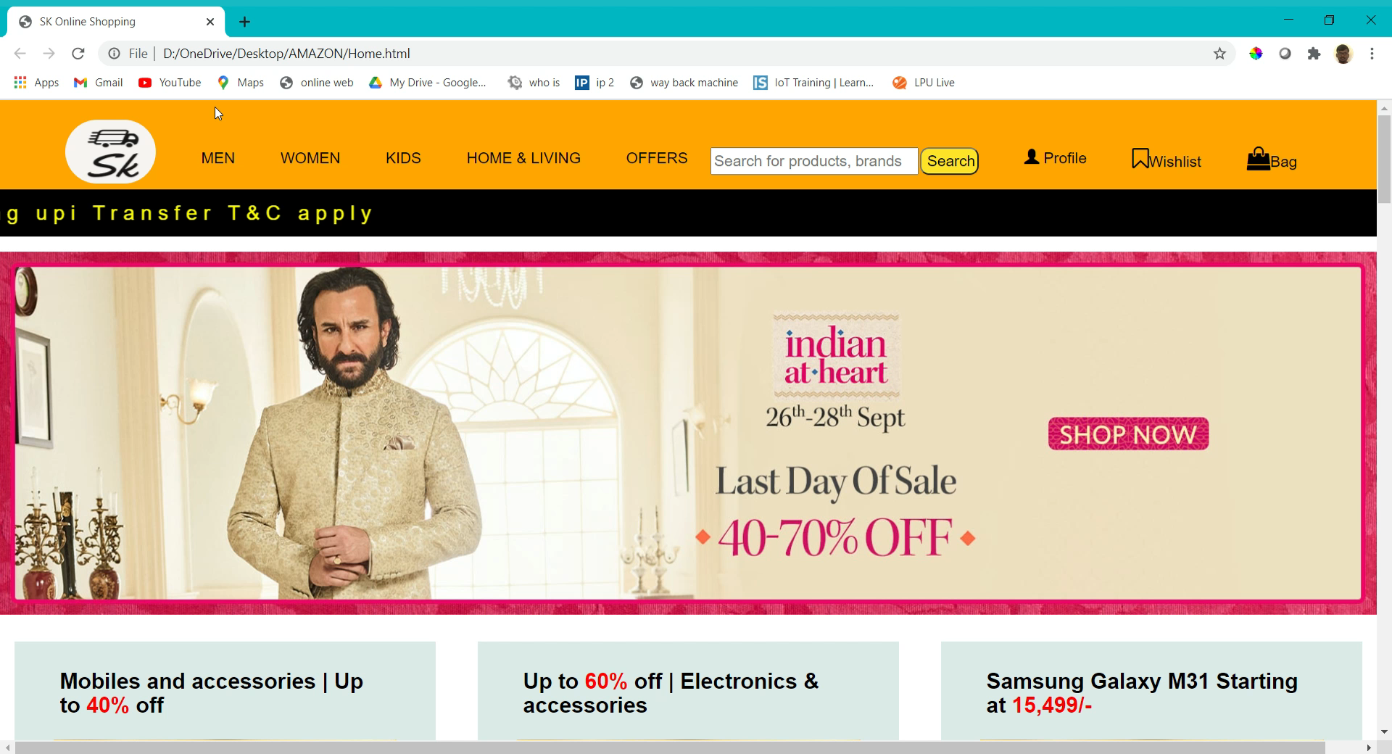
Screen Recording :-
Home.html

Slide 8
Video on the whole project:-
Link for the video presentation:-
https://drive.google.com/file/d/1eCTlwA3171w9yAxB0T0vVVuM-s3pMvgn/view?usp=sharing

Slide 9
References:
Whole Project Link:-
https://drive.google.com/drive/folders/1dRgtKyW00zqLK2j0f64_HGk9q1BafwGe?usp=sharing

Slide 10
THANK YOU

